Slide 1

MySQL III

Slide 2
Objectives
SQL join types
PHP connect to MySQL
CRUD operations using PHP/MySQL

Slide 3
SQL JOIN
A JOIN clause is used to combine rows from two or more tables, based on a related column between them.
Different Types of SQL JOINs
(INNER) JOIN: Returns records that have matching values in both tables
LEFT (OUTER) JOIN: Return all records from the left table, and the matched records from the right table
RIGHT (OUTER) JOIN: Return all records from the right table, and the matched records from the left table
FULL (OUTER) JOIN: Return all records when there is a match in either left or right table

Slide 4



SQL INNER JOIN
The INNER JOIN keyword selects records that have matching values in both tables.
Syntax
Example

Slide 5
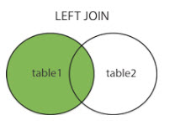


SQL LEFT JOIN
The LEFT JOIN keyword returns all records from the left table (table1), and the matched records from the right table (table2). The result is NULL from the right side, if there is no match.
Syntax
Example

Slide 6

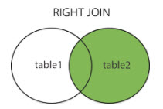

SQL RIGHT JOIN
The RIGHT JOIN keyword returns all records from the right table (table2), and the matched records from the left table (table1). The result is NULL from the left side, when there is no match.
Syntax
Example

Slide 7
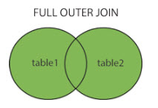


FULL OUTER JOIN
The FULL OUTER JOIN keyword return all records when there is a match in either left (table1) or right (table2) table records.
Note: FULL OUTER JOIN can potentially return very large result-sets!
Syntax
Example

Slide 8
Demo
Teacher demo join types for students

Slide 9
PHP Connect to MySQL
PHP 5 and later can work with a MySQL database using:
MySQLi extension (the "i" stands for improved)
PDO (PHP Data Objects)
Note: Earlier versions of PHP used the MySQL extension. However, this extension was deprecated in 2012.
Both MySQLi and PDO have their advantages:
PDO will work on 12 different database systems, whereas MySQLi will only work with MySQL databases.
So, if you have to switch your project to use another database, PDO makes the process easy. You only have to change the connection string and a few queries. With MySQLi, you will need to rewrite the entire code - queries included.
Both are object-oriented, but MySQLi also offers a procedural API.
Both support Prepared Statements. Prepared Statements protect from SQL injection, and are very important for web application security.

Slide 10
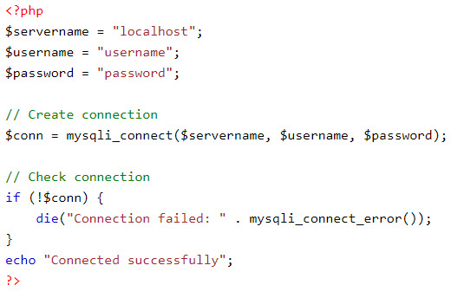
Open a Connection
Before we can access data in the MySQL database, we need to be able to connect to the server.
Example

Slide 11
Close the Connection
The connection will be closed automatically when the script ends. To close the connection before, use the following:
mysqli_close($conn);

Slide 12
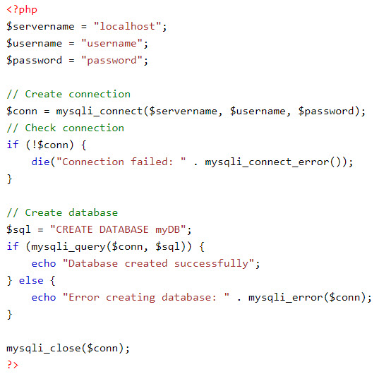
PHP Create Database
A database consists of one or more tables.
The CREATE DATABASE statement is used to create a database in MySQL.
Example

Slide 13
Create MySQL Tables
A database table has its own unique name and consists of columns and rows.
The CREATE TABLE statement is used to create a table in MySQL.
The data type specifies what type of data the column can hold.
After the data type, you can specify other optional attributes for each column:
NOT NULL - Each row must contain a value for that column, null values are not allowed
DEFAULT value - Set a default value that is added when no other value is passed
UNSIGNED - Used for number types, limits the stored data to positive numbers and zero
AUTO INCREMENT - MySQL automatically increases the value of the field by 1 each time a new record is added
PRIMARY KEY - Used to uniquely identify the rows in a table. The column with PRIMARY KEY setting is often an ID number, and is often used with AUTO_INCREMENT
Each table should have a primary key column (in this case: the "id" column). Its value must be unique for each record in the table.

Slide 14
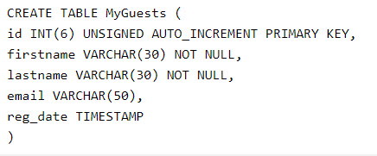
Example
Example creating table:

Slide 15
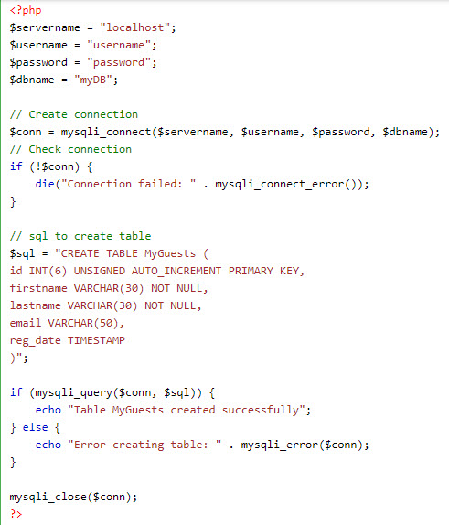
Example

Slide 16

Insert Data Into MySQL
After a database and a table have been created, we can start adding data in them.
Here are some syntax rules to follow:
The SQL query must be quoted in PHP
String values inside the SQL query must be quoted
Numeric values must not be quoted
The word NULL must not be quoted
The INSERT INTO statement is used to add new records to a MySQL table:
Note: If a column is AUTO_INCREMENT (like the "id" column) or TIMESTAMP (like the "reg_date" column), it is no need to be specified in the SQL query; MySQL will automatically add the value.

Slide 17
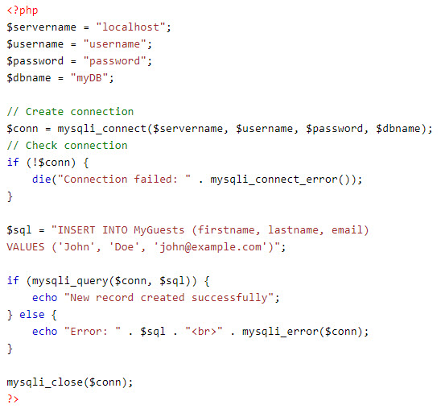
Example

Slide 18
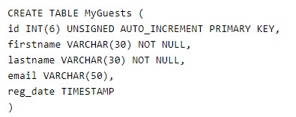
Get ID of Last Inserted Record
If we perform an INSERT or UPDATE on a table with an AUTO_INCREMENT field, we can get the ID of the last inserted/updated record immediately.
In the table "MyGuests", the "id" column is an AUTO_INCREMENT field:

Slide 19
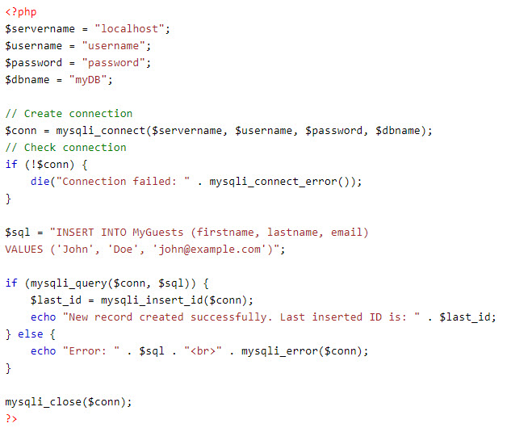
Example

Slide 20
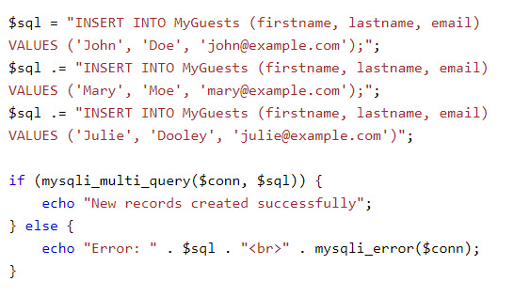
Insert Multiple Records
Multiple SQL statements must be executed with the mysqli_multi_query() function.
Note: that each SQL statement must be separated by a semicolon.
Example:

Slide 21

Select Data
The SELECT statement is used to select data from one or more tables
or we can use the * character to select ALL columns from a table

Slide 22
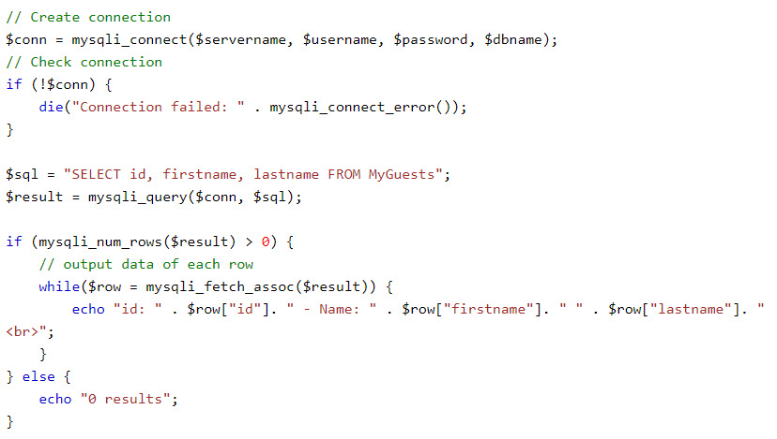
Example

Slide 23

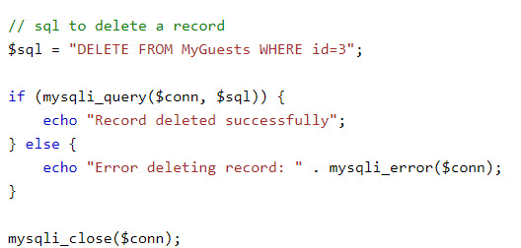
Delete Data
The DELETE statement is used to delete records from a table
Example

Slide 24

Update Data
The UPDATE statement is used to update existing records in a table
Note: The WHERE clause specifies which record or records that should be updated. If you omit the WHERE clause, all records will be updated !
Example

Slide 25
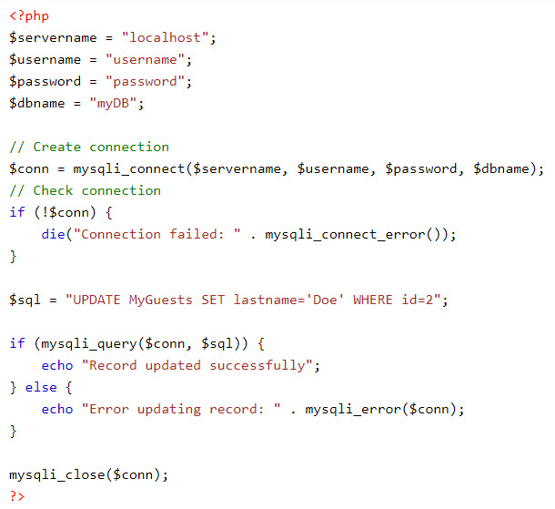
Example

Slide 26
Demo
Teacher demo code about CRUD operation with MySQL

Slide 27
Summary
SQL join types
PHP connect to MySQL
CRUD operations using PHP/MySQL

